Slide 1
PRISMS-PF: The PRISMS Phase Field Code
Trainers:
Steve DeWitt (PRISMS-PF Lead Developer)
Beck Andrews
David Montiel

Slide 2
Training Objective
Learn enough of PRISMS-PF to allow you to go home and start using it in your work

Slide 3
Plan for the Training
Schedule:
Brief introductory comments
Guided walkthrough
Tour of the file system
Running example applications
Visualization
Tutorial on writing equations in the weak form
Walkthrough of the application files
Individual exercises using PRISMS-PF to modify existing applications and create new applications
Now
This morning
This afternoon
and
Wednesday

Slide 4
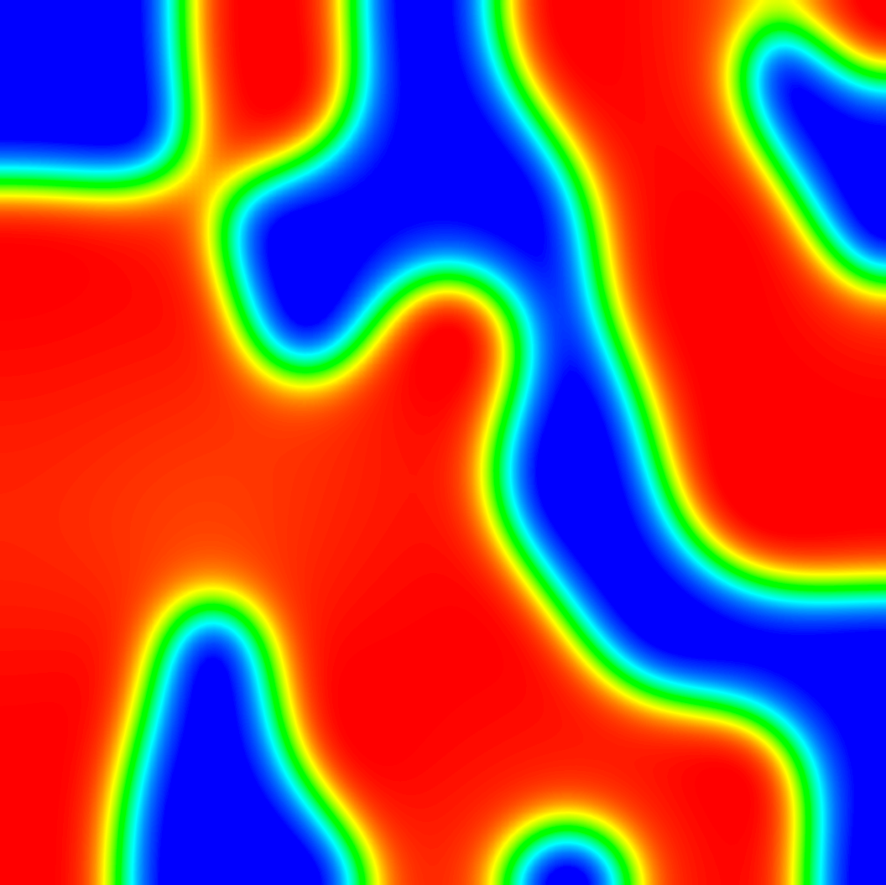
One Slide on Phase Field Modeling
Phase field modeling is a diffuse interface approach to modeling microstructure evolution
Examines phase separation in systems with two or more minima in their free energy
Two main equations:
Cahn-Hilliard: conserved dynamics
(e.g. concentration)
Allen-Cahn: nonconserved dynamics
(e.g. grain orientation)
Applications include: solidification, precipitation, grain growth, phase separation in batteries, deposition, ferroics
Spinodal Decomposition
(Cahn-Hilliard Equation)

Slide 5
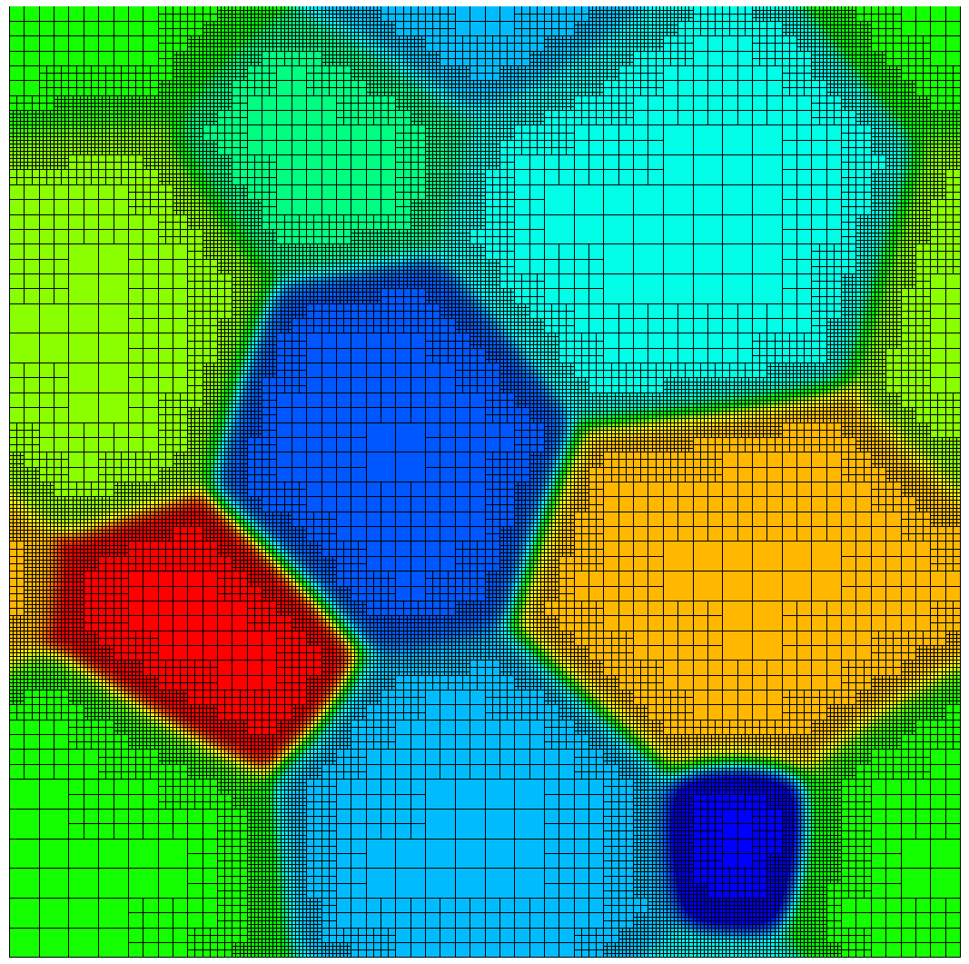
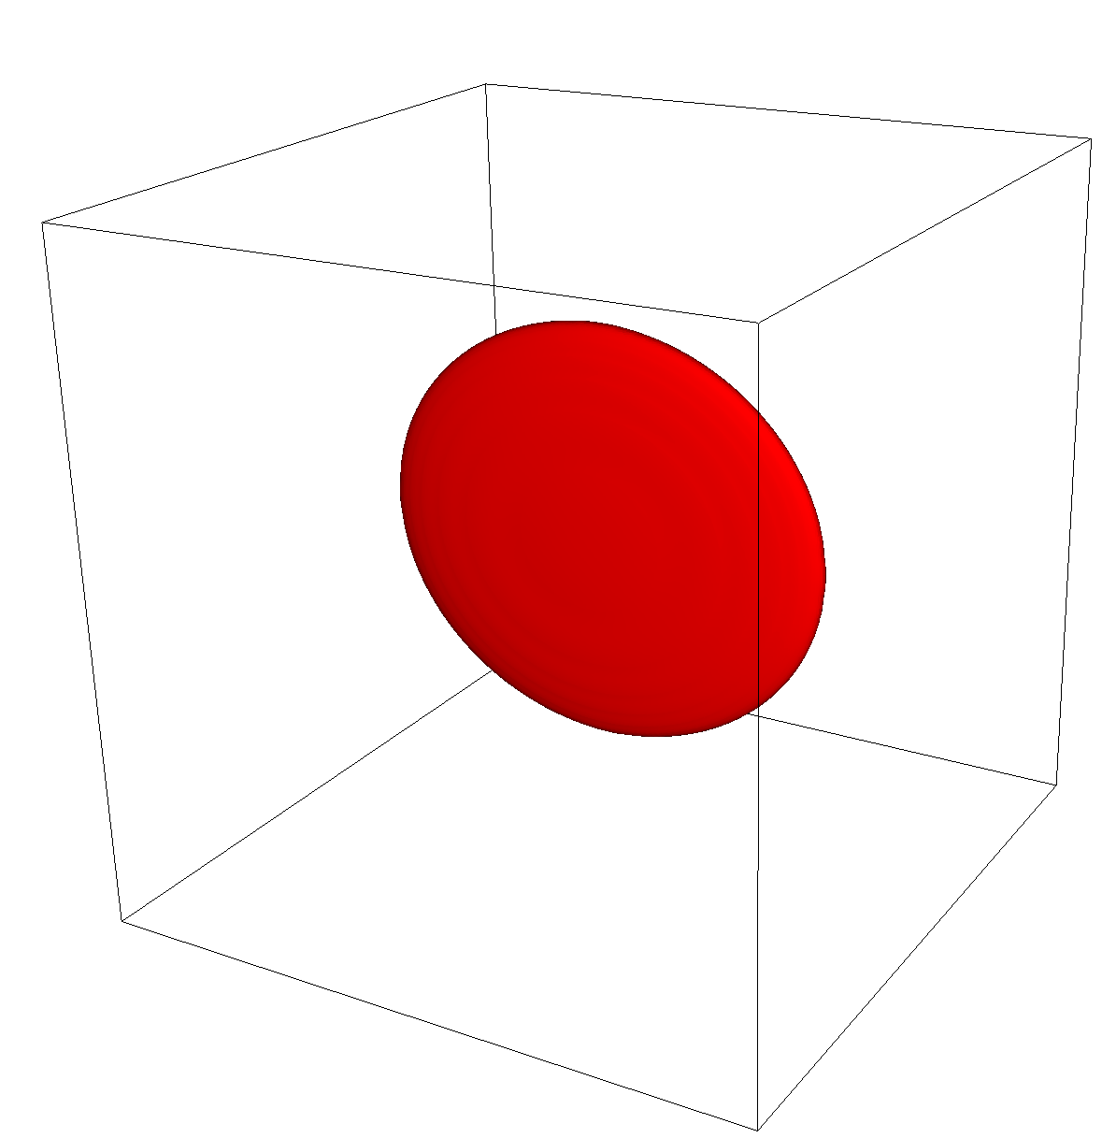
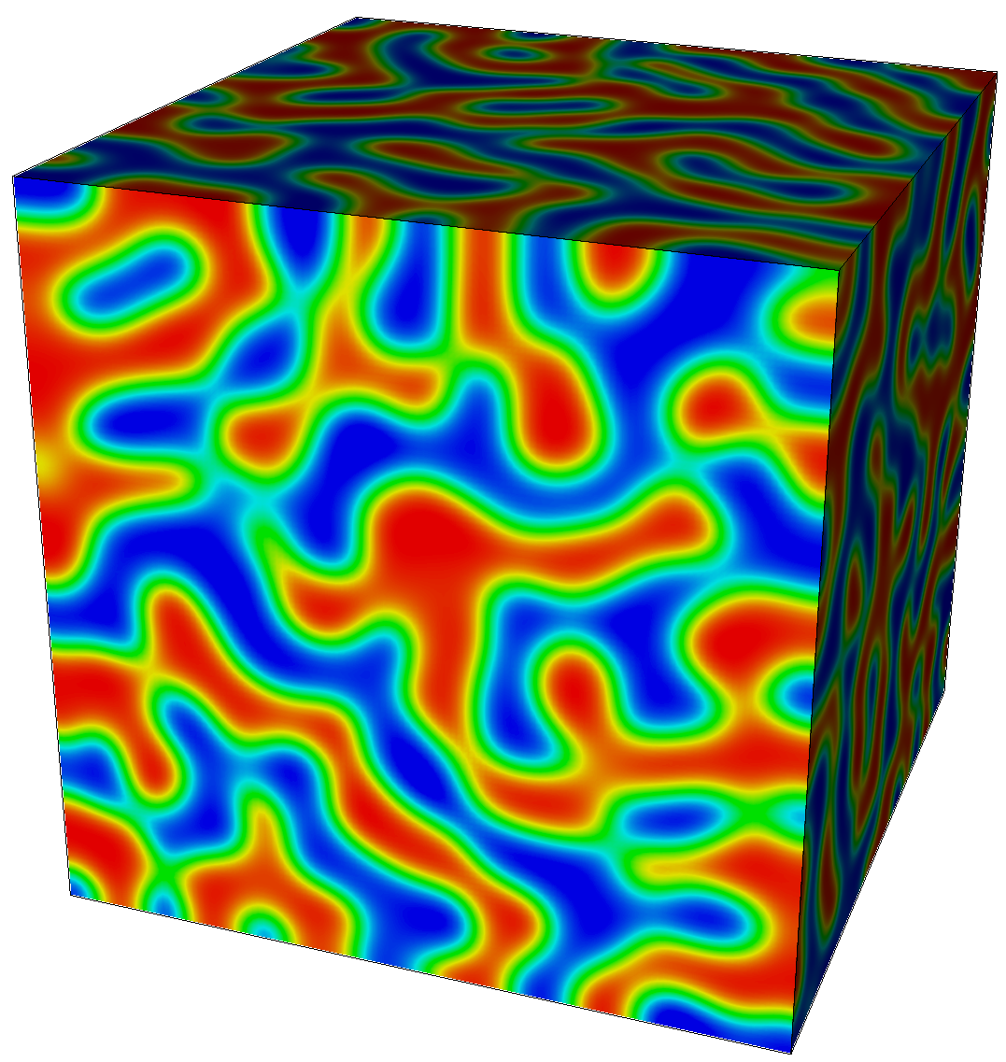
PRISMS-PF:
An Open Source, Finite Element,
General Purpose Phase-Field Platform
(github.com/prisms-center/phaseField)
User-Friendly:
Simple interface to solve an arbitrary number of PDEs
Detailed user guide
18 applications (and counting) to get you started
High-Performance:
Ideal scaling for >1,000 processors
Matrix-free method permits >10⁹ DOF
Adaptive meshing
Competitive performance with finite difference (even without adaptive meshing)

Slide 6
Structure of PRISMS-PF
Core library
Generates mesh, does the finite element calculation, outputs files, etc.
Apps
Each app is a directory that contains an input file and some application files
Governing equations, boundary conditions, initial conditions, numerical and model parameters, postprocessing expressions
Copy and paste an app directory to create a new app
Tests
Suite of unit and regression tests

Slide 7
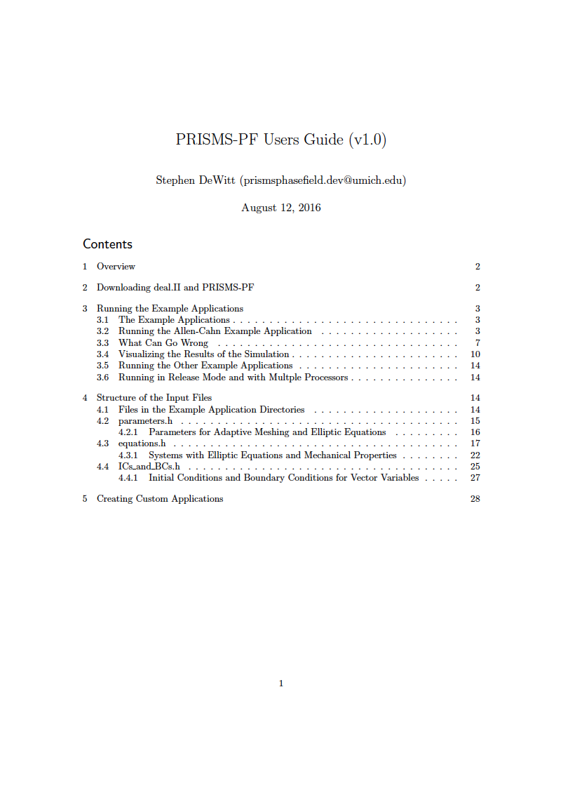
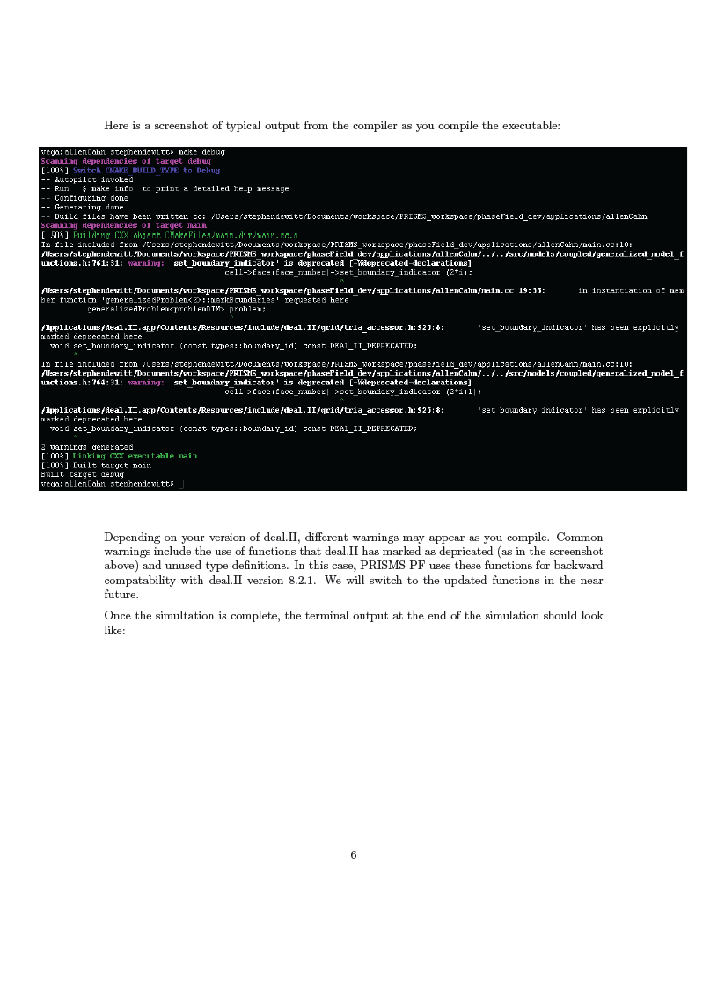
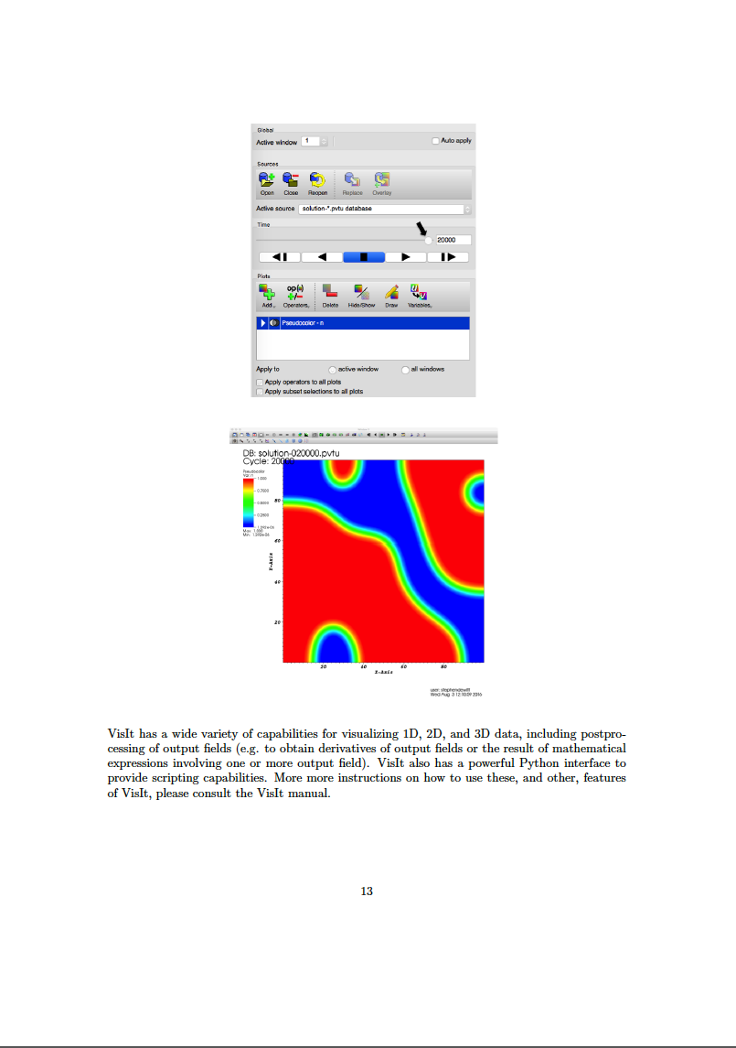
User’s Guide
Instructions for downloading and installing PRISMS-PF and pre-requisites
Instructions for running the pre-built applications and visualizing the results
A description of the application files and how to create custom applications

Slide 8
Three Types of PRISMS-PF Users
Uses PRISMS-PF applications
No C++ knowledge needed
No deal.II knowledge needed
Creates PRISMS-PF applications
Minimal C++ knowledge needed
No deal.II knowledge needed
Extends PRISMS-PF itself
C++ knowledge needed
deal.II knowledge needed

Slide 9
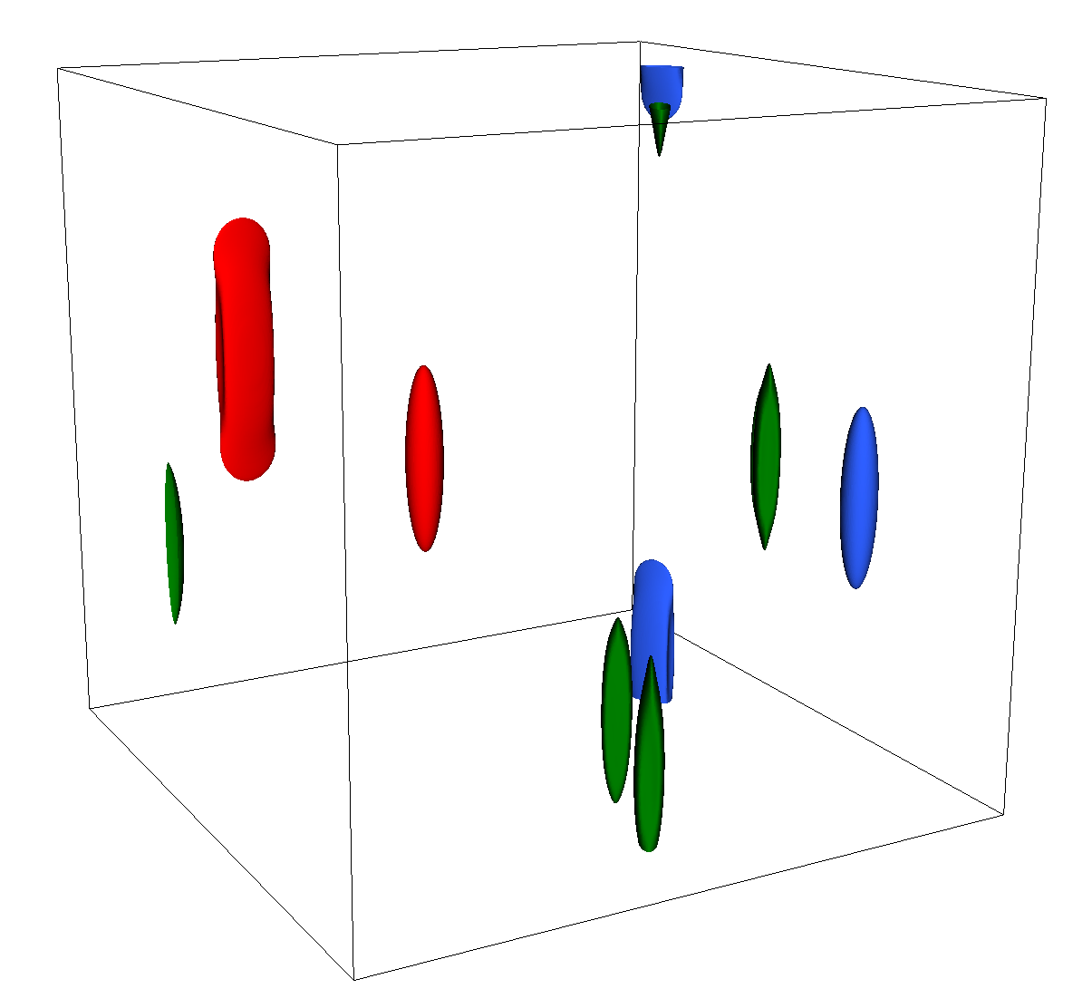
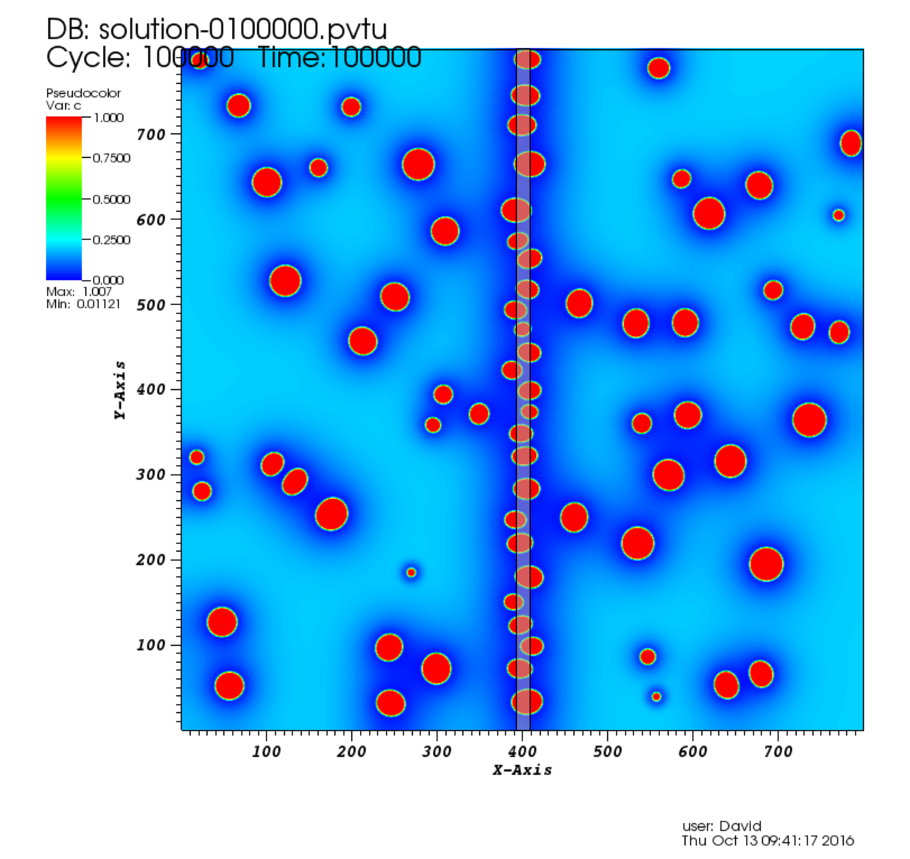
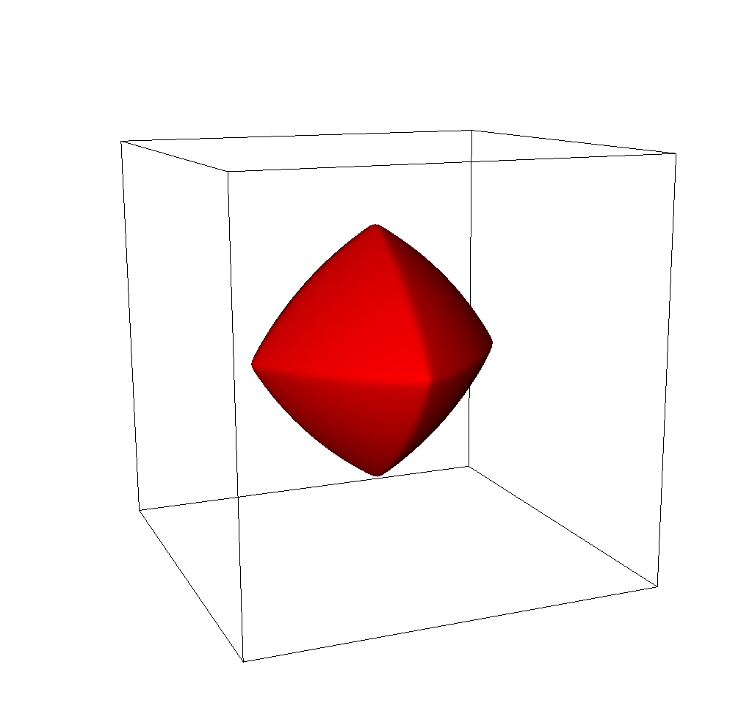
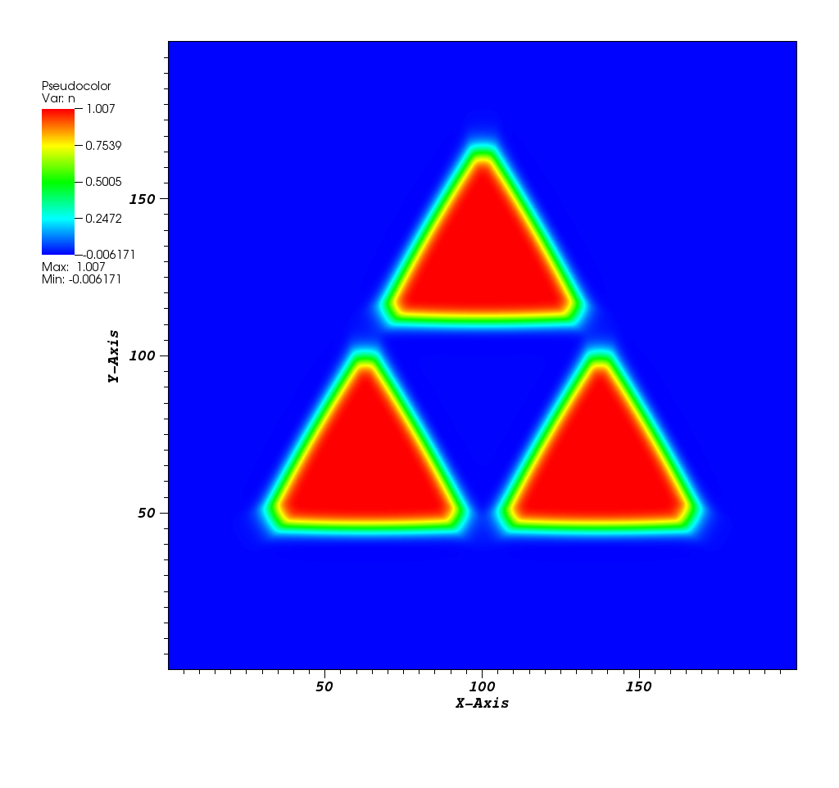
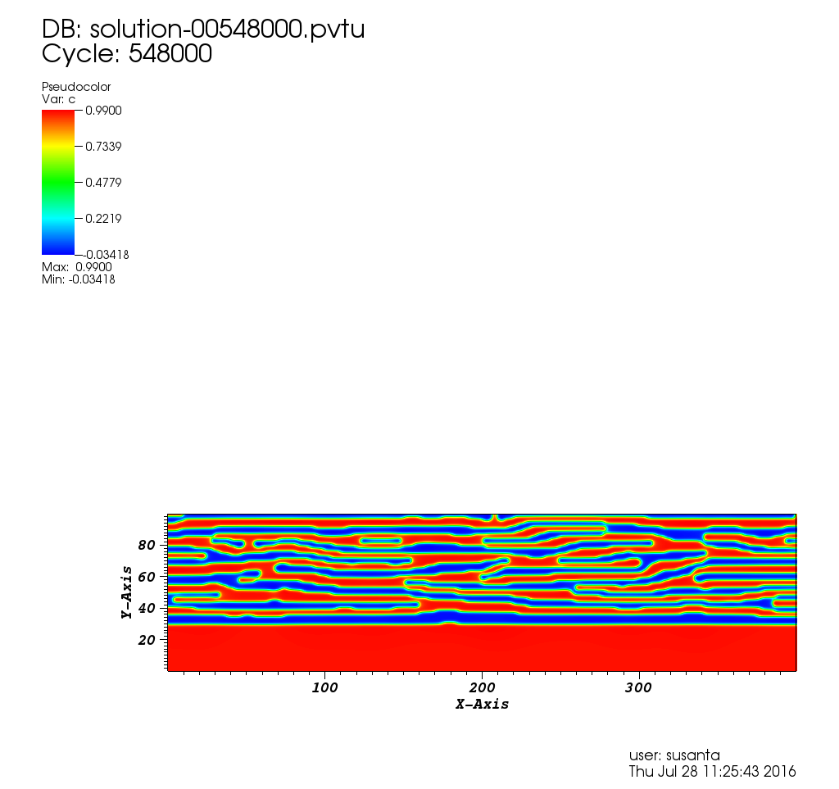
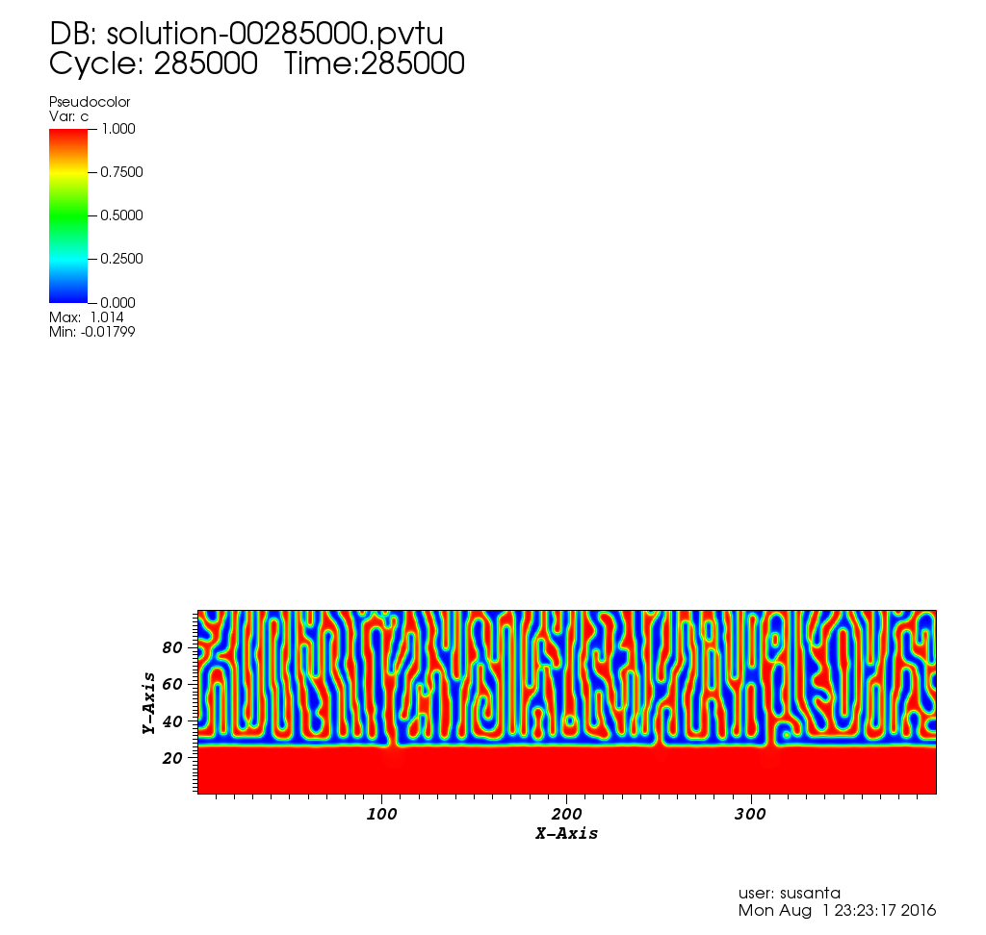
Phase Field Modeling with PRISMS-PF at UM
Mg-RE Precipitates
Precipitation near Grain Boundaries
Strong Interfacial Energy Anisotropy
Spinodal Decomposition in Strained Thin Films (Non-PRISMS)
9

Slide 11
Downloading PRISMS-PF
https://github.com/prisms-center/phaseField

Slide 12
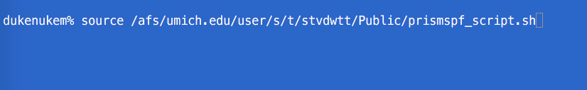
Setting Environment Variables
Type this on the command line:
source /afs/umich.edu/user/s/t/stvdwtt/Public/prismspf_script.sh

